Slide 1

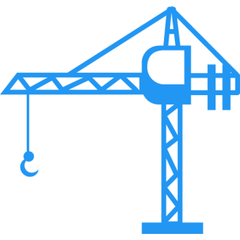

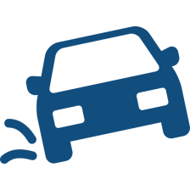

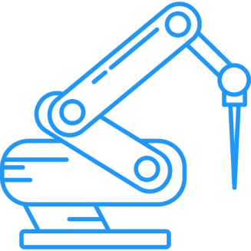



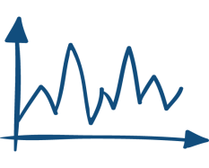
optimization
feedback control
robustness
learning control
model identification

Slide 2
Converged error
an optimal
compromise solution
Convergence speed

Slide 4

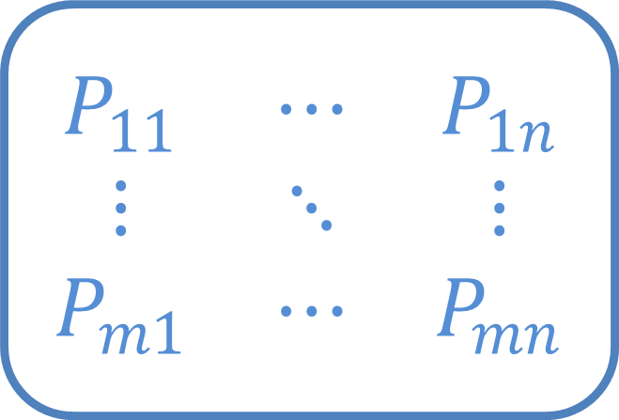

$$\begin{matrix}P_{11} & ⋯ & P_{1n} \\ ⋮ & ⋱ & ⋮ \\ P_{m1} & ⋯ & P_{mn}\end{matrix}$$
$$⋮$$
$$⋮$$
MIMO system

Slide 5
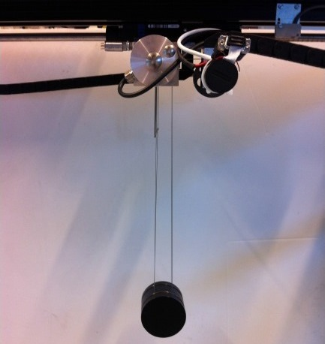

Slide 6
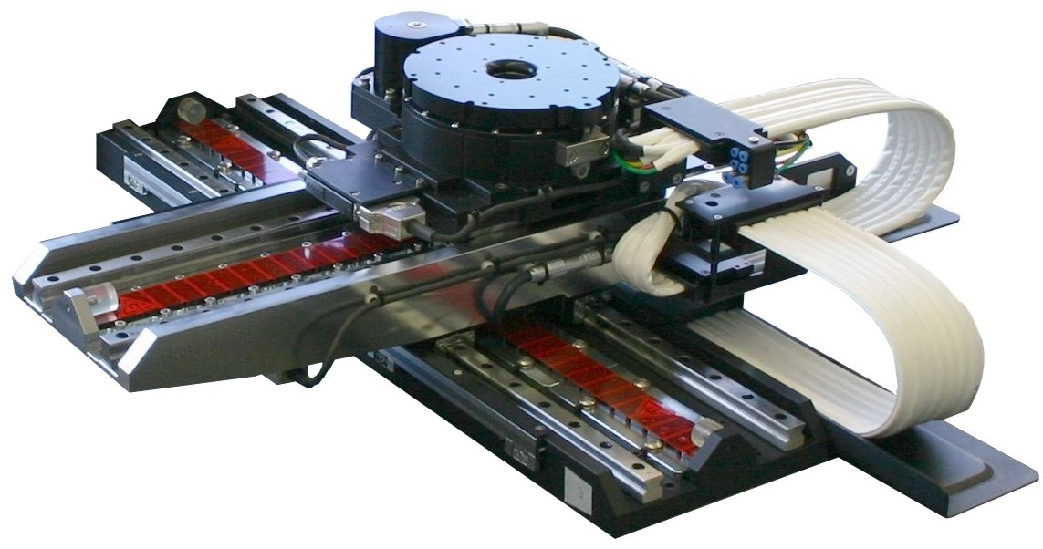

Slide 7
Iterative Learning Control
Iterative learning control (ILC) is widely used in control applications to improve performance of repetitive processes. Examples of ILC applications are: industrial robots (i.e. pick-and-place robots, gantry robots, cutting robots), motion systems (wafer stage, medical rehabilitation equipment…), batch processes (chemical processes, rapid thermal processing). The key idea of ILC is to update the control signal iteratively based on measured data from previous trials, such that the output converges to the given reference trajectory.

Slide 8
The novelty of this work has two folds. First, we aim to design a one-step optimization based ILC design to solve for noncausal Q-filter and learning function simultaneously. Second, multiple ILC objectives are incorporated into our ILC algorithm.
\begin{align}
\begin{array}{ll}
\displaystyle\min_{Q(\mathrm{q}),\; L(\mathrm{q})} & \text{convergence speed} \\
\text{subject to} & \text{robust convergence} \\
& \text{robust performance}\\
& \text{input constraint}.
\end{array}
\end{align}
We reformulate the problem as a convex problem, guaranteeing an efficient and reliable computation of the global optimum and allowing straightforward computation of trade-off curves between different performance indices. These trade-off curves aid the control engineers in selecting their desired controller taking into account different objectives.

